Slide 1
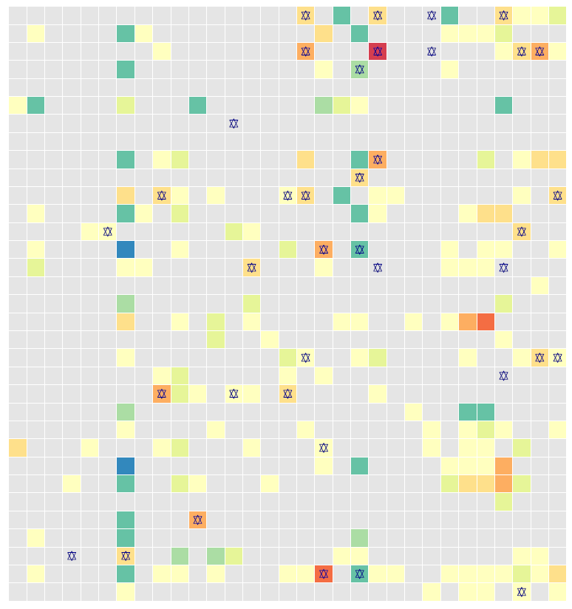
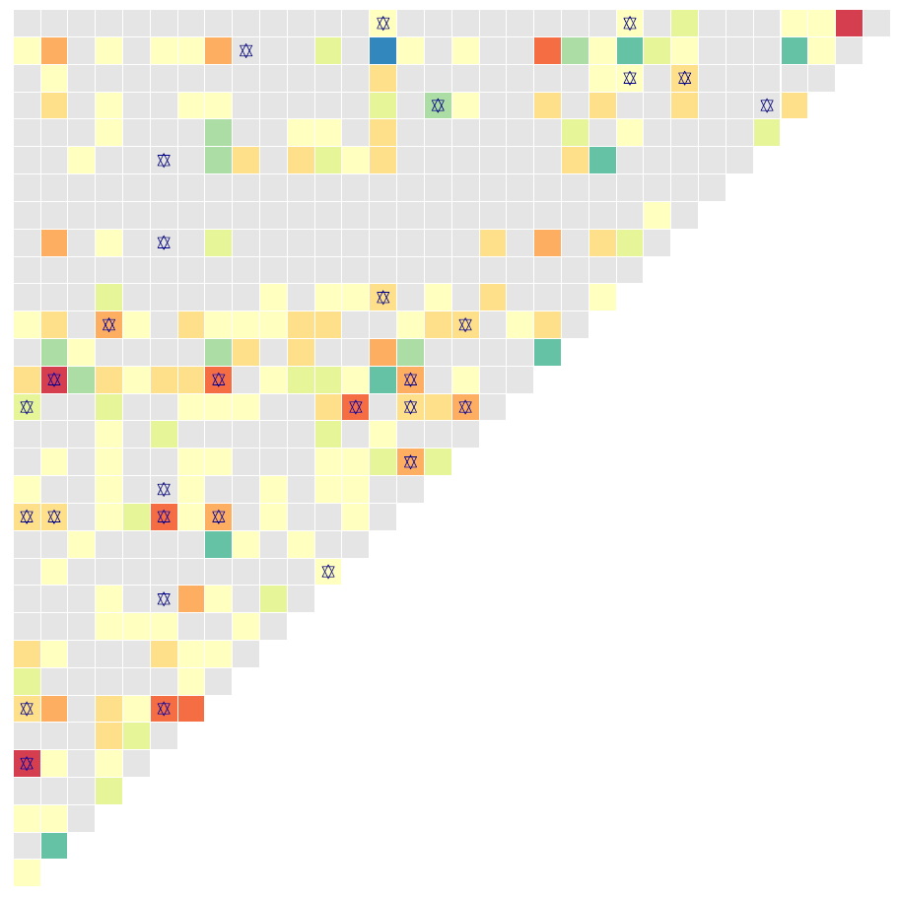
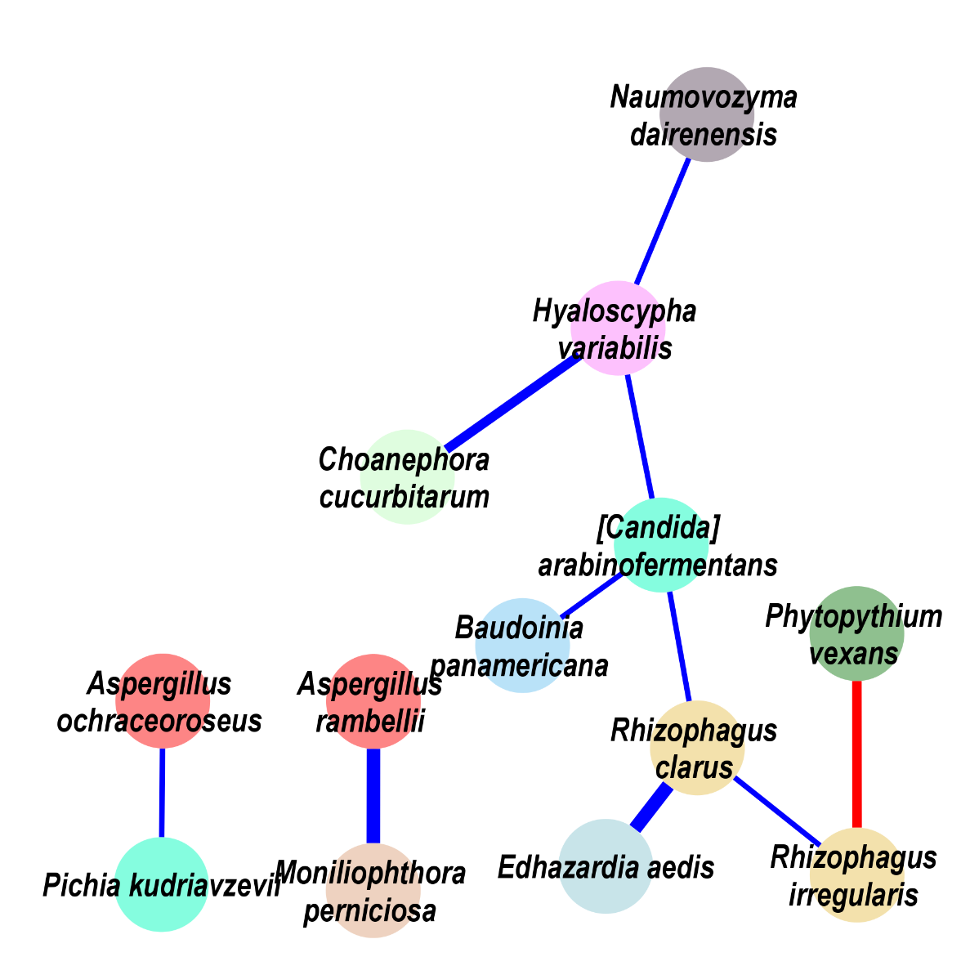
Fungi
Adenoma
Escherichia coli | Bifidobacterium longum | Ruminococcus bicirculans | Adlercreutzia equolifaciens | Bifidobacterium adolescentis | Streptococcus thermophilus | Prevotella intermedia | Bifidobacterium bifidum | Streptococcus milleri | Streptococcus equinus | Bifidobacterium pseudocatenulatum | Streptococcus salivarius | Bifidobacterium angulatum | Lactobacillus ruminis | Bifidobacterium catenulatum | Streptococcus anginosus | Fusobacterium periodonticum | Clostridium beijerinckii | [Eubacterium] eligens | Porphyromonas asaccharolytica | Romboutsia ilealis | Brachyspira pilosicoli | Lactococcus garvieae | Dialister pneumosintes | Roseburia intestinalis | Butyrivibrio proteoclasticus | Pseudobutyrivibrio xylanivorans | Anaerostipes hadrus | Gemella morbillorum | Parvimonas micra | Fusobacterium nucleatum
Choanephora cucurbitarum | Edhazardia aedis | Thielaviopsis punctulata | Tuber magnatum | Schizosaccharomyces pombe | Hyaloscypha variabilis | Baudoinia panamericana | [Candida] arabinofermentans | Colletotrichum salicis | Leucoagaricus sp. SymC.cos | Coniochaeta ligniaria | Colletotrichum fioriniae | Aspergillus ochraceoroseus | Phytopythium vexans | Naumovozyma dairenensis | Lipomyces starkeyi | Albugo candida | Paracoccidioides brasiliensis | Pichia kudriavzevii | Rhizophagus clarus | Cordyceps sp. RAO−2017 | Pseudocercospora musae | Trichoderma atroviride | Debaryomyces hansenii | Pneumocystis murina | Aspergillus kawachii | Trichophyton mentagrophytes | Phytophthora capsici | Sphaerulina musiva | Erysiphe pulchra | Moniliophthora perniciosa | Rhizophagus irregularis | Aspergillus rambellii
Aspergillus rambellii
Rhizophagus irregularis
Moniliophthora perniciosa
Erysiphe pulchra
Sphaerulina musiva
Phytophthora capsici
Trichophyton mentagrophytes
Aspergillus kawachii
Pneumocystis murina
Debaryomyces hansenii
Trichoderma atroviride
Pseudocercospora musae
Cordyceps sp. RAO−2017
Rhizophagus clarus
Pichia kudriavzevii
Paracoccidioides brasiliensis
Albugo candida
Lipomyces starkeyi
Naumovozyma dairenensis
Phytopythium vexans
Aspergillus ochraceoroseus
Colletotrichum fioriniae
Coniochaeta ligniaria
Leucoagaricus sp. SymC.cos
Colletotrichum salicis
[Candida] arabinofermentans
Baudoinia panamericana
Hyaloscypha variabilis
Schizosaccharomyces pombe
Tuber magnatum
Thielaviopsis punctulata
Edhazardia aedis
Choanephora cucurbitarum
Fungi
S figure 4

